Slide 1
Chapter 23:
ELECTRIC CURRENT

Slide 2
This lecture will help you understand:
Flow of Charge
Electric Current
Voltage Sources
Electrical Resistance
Ohm’s Law
Direct Current and Alternating Current
Speed and Source of Electrons in a Circuit
Electric Power
Compact Fluorescent Lamps (CFLs)
Light-Emitting Diodes (LEDs)
Electric Circuits

Slide 3
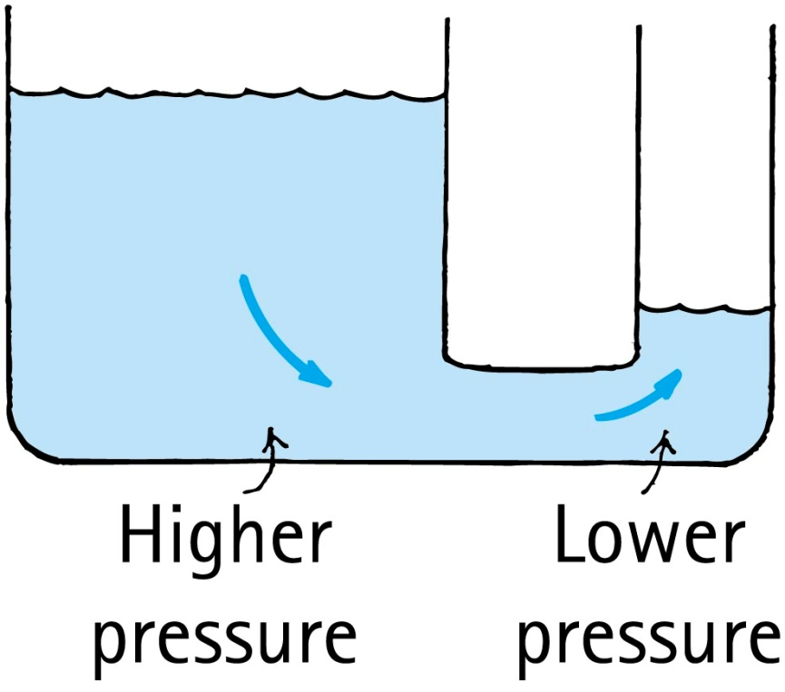
Flow of Charge
When the ends of an electrical conductor are at different electric potentials—when there is a potential difference—charge flows from one end to the other and stops when there’s not.
  Analogous to water flowing from higher pressure to lower pressure

Slide 4
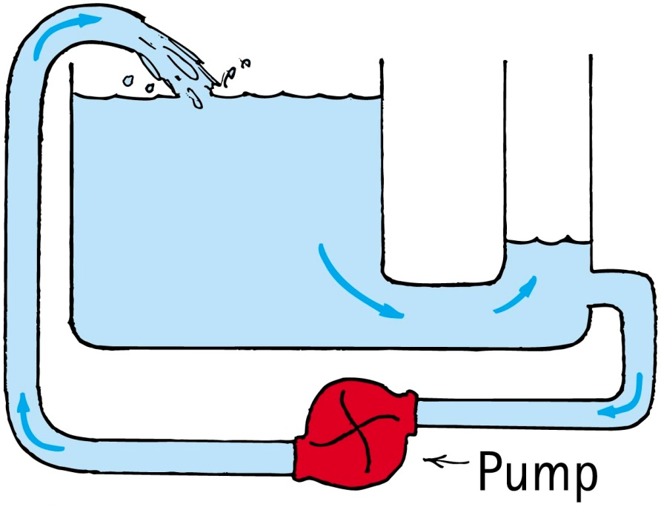
Flow of Charge
To attain a sustained flow of charge in a conductor, some arrangement must be provided to maintain a difference in potential while charge flows from one end to the other.
  A continuous flow is possible if the difference in water levels—hence the difference in water pressures—is maintained with the use of a pump.

Slide 5
Electric Current
Electric current is the flow of electric charge.
In conductors the electrons that move from one atom or molecule to another are called charge carriers.
Protons don’t move but in conducting fluids the positive ions will move and produce the flow of charge.
Although charge is moving in a conductor the net charge is normally zero.

Slide 6
Which of these statements is true?
Electric Current
CHECK YOUR NEIGHBOR
A. Electric current is a flow of electric charge.
Electric current is stored in batteries.
Both A and B are true.
Neither A nor B are true.
Notes:
A. Electric current is a flow of electric charge.

Slide 7
Which of these statements is true?
Electric Current
CHECK YOUR ANSWER
A. Electric current is a flow of electric charge.
Electric current is stored in batteries.
Both A and B are true.
Neither A nor B are true.
Explanation:
Voltage, not current, is stored in batteries. The voltage will produce a current in a connecting circuit. The battery moves electrons already in the wire, but not necessarily those in the battery.
Notes:
A. Electric current is a flow of electric charge.

Slide 8
Electric Current
Rate of electric flow
Measured in ampere (1 coulomb of charge per second). = 6.25 x 10¹⁸ electrons /second
Speed of electrons (drift speed) through a wire is slow because of continuous bumping of electrons in wire.
Charge flows through a circuit; voltage is established across a circuit.

Slide 9
Electric Current
Alternating current
Electrons oscillate to and fro around fixed positions.
Movement is produced by a generator or an alternator that switches the signs of charge periodically.
Commercial ac circuits are used in most residential circuits throughout the world and can be stepped up to high voltage for transmission over great distances with small heat losses, or stepped down where energy is consumed.

Slide 10
Voltage Sources
Conductor
Any material having free charged particles that easily flow through it when an electric force acts on them

Slide 11
Voltage Sources
Electric potential difference
Difference in potential between two points
  Charges in conductor flow from higher potential to lower potential.
  Flow of charge persists until both ends of conductor reach the same potential.
  Maintained for continuous flow by pumping device.

Slide 12
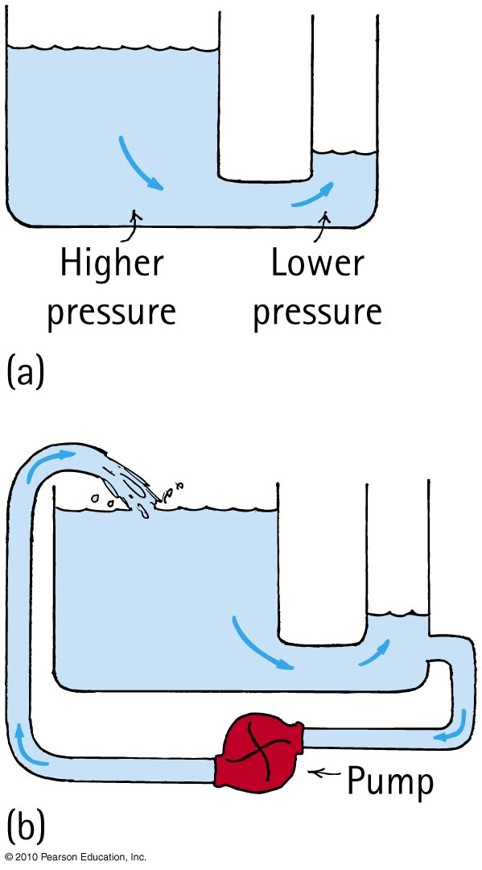
Voltage Sources
Electric potential difference (continued)
  Example: Water from a higher reservoir to a lower one—flow continues until no difference
  No flow of charge occurs when potential difference is zero.

Slide 13
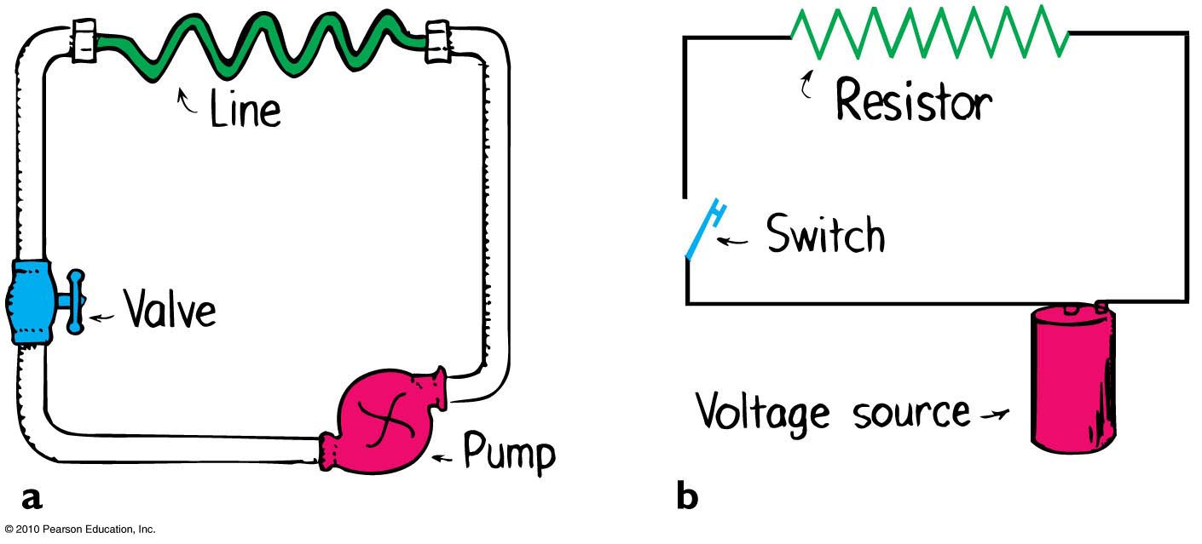
Voltage Sources
Electric potential difference (continued)
A battery or generator can maintain a steady flow of charge.
  Work is done in pulling negative charges apart from positive ones.
  Electromagnetic induction at the generator terminals provides the electrical pressure to move electrons through the circuit.

Slide 14
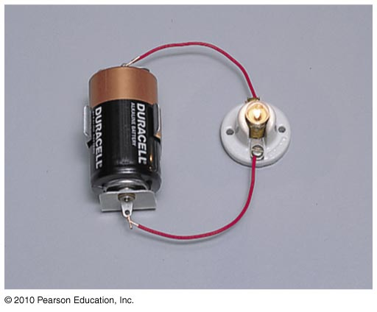
Voltage Sources
Electric potential difference
In chemical batteries
  Work by chemical disintegration of zinc or lead in acid.
  Energy stored in chemical bonds is converted to electric potential energy.

Slide 15
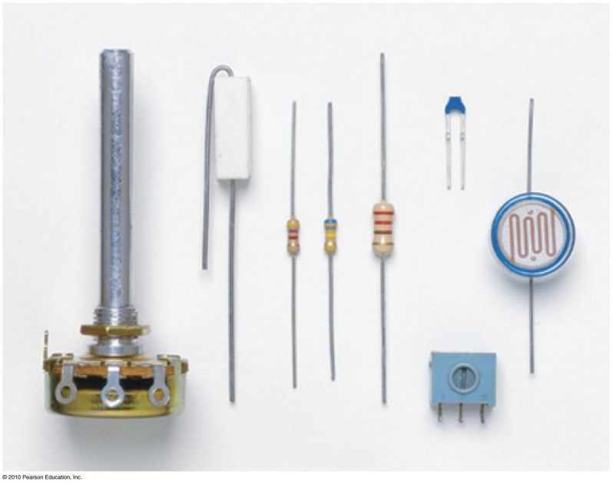

Electric Resistance
Current in a circuit is dependent on
voltage.
electrical resistance in ohms.
Resistors
circuit elements that regulate current inside electrical devices
Resistors. The symbol of resistance in an electric circuit is .

Slide 16
Electric Resistance
Factors affecting electrical resistance:
Inversely proportional to cross-sectional area
  thin wires, more resistance than thick wires
Directly proportional to length
  doubling the length, doubles the resistance
Material
  rubber—much more resistance than copper of the same size

Slide 17
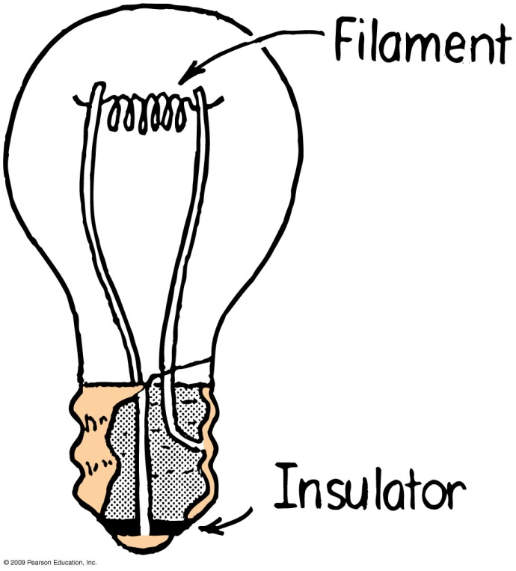
Electric Resistance
Factors affecting electrical resistance (continued)
  Temperature
    the higher the temperature, the more the resistance

Slide 18
Electric Resistance
Semiconductors
Refers to materials that can alternate between being conductors and insulators
Example:
  germanium
  silicon

Slide 19
Electric Resistance
Superconductors
Materials with zero electrical resistance to the flow of charge.
Flow of charge is without generation of heat.
High-temperature superconductors
Refers to ceramic materials that can carry much current at a low voltage.

Slide 20
Ohm’s Law
Ohm’s law
Relationship between voltage, current, and resistance
States that the current in a circuit varies in direct proportion to the potential difference, or voltage, and inversely with the resistance

Slide 21
Ohm’s Law
Ohm’s law (continued)
In equation form:
Example:
  For a constant resistance, current will be twice as much for twice the voltage.
  For twice the resistance and twice the voltage, current will be unchanged.
Resistors
Circuit elements that regulate current inside electrical devices.
voltage
Current =
resistance

Slide 22
When you double the voltage in a simple electric circuit, you double the
Ohm’s Law
CHECK YOUR NEIGHBOR
A. current.
resistance.
Both A and B.
Neither A nor B.
Notes:
A. current.

Slide 23
When you double the voltage in a simple electric circuit, you double the
Ohm’s Law
CHECK YOUR ANSWER
A. current.
resistance.
Both A and B.
Neither A nor B.
Explanation:
This is a straightforward application of Ohm’s law.
voltage
Current =
resistance
Notes:
A. current.

Slide 24

Ohm’s Law
Electric shock
Damaging effects of shock result from current passing through the body.
From ohm’s law the current flow depends on the resistance and the voltage.
Electric potential difference between one part of your body and another part depends on body condition and resistance, which can range from 100 ohms to 500,000 ohms.

Slide 25
Ohm’s Law and Electric Shock
Voltages up to 24 volts cause discomfort but not damage but 120 volts can cause damage depending on the circumstances.
How and where the voltage is applied and whether you are wet or dry.

Slide 26
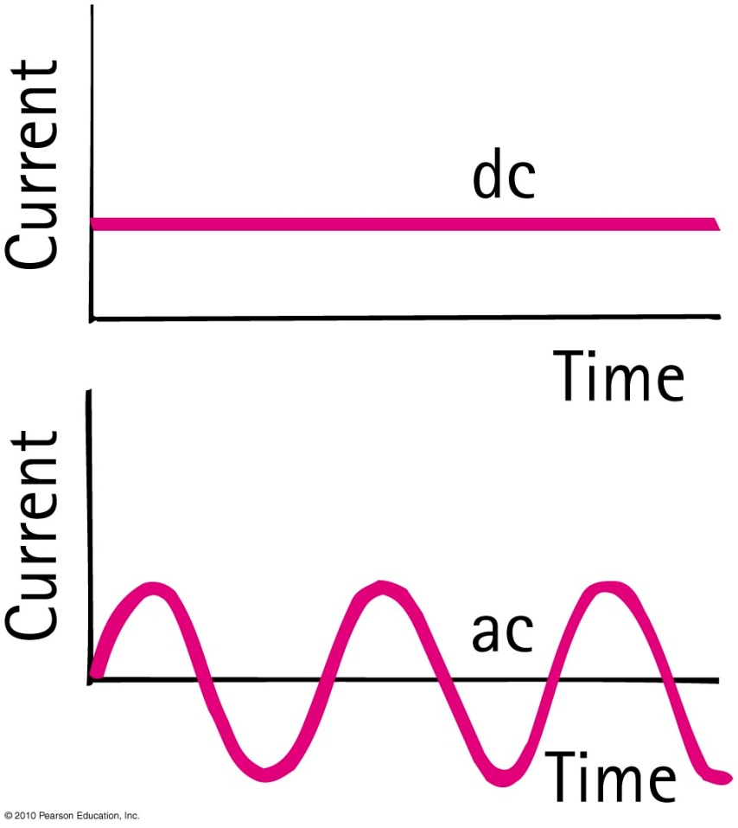
Direct and Alternating Current
Direct current (dc)
  Flows in one direction only.
  Electrons always move from the negative terminal toward the positive terminal.
Alternating Current (ac)
  Electrons in the circuit are moved first in one direction and then in the opposite direction, alternating to and fro about fixed positions.
  This is accomplished by alternating the polarity of voltage at the generator or other voltage source.

Slide 27
Direct and Alternating Current
Commercial electricity in North America
  Alternating current (ac)
  60 cycles per second
  Voltage is 120 V
Power transmission is more efficient at higher voltages.
  Europe adopted 220 V as its standard.
  U.S. continued with 120 V because so much equipment was already installed.

Slide 28
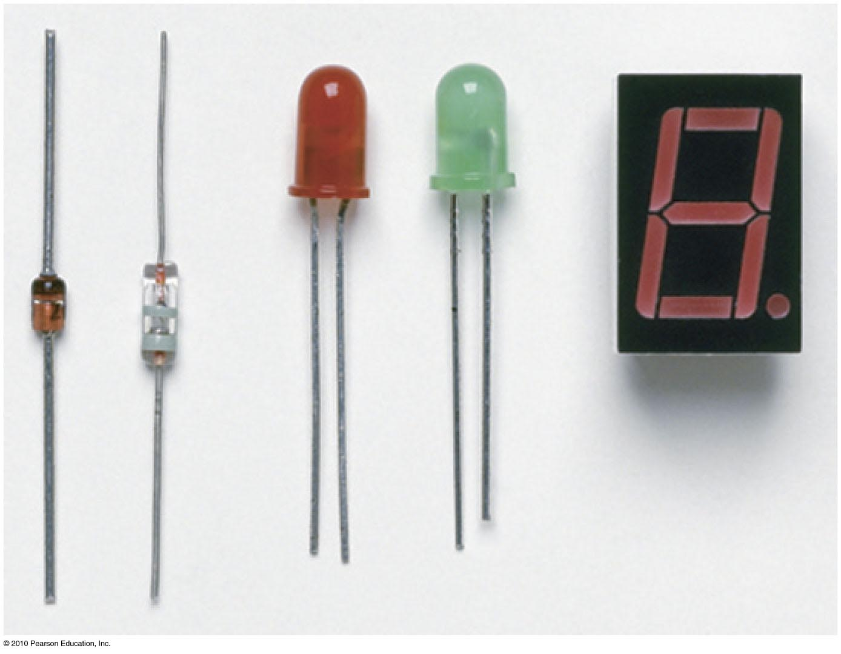
Direct and Alternating Current
Converting from ac to dc
  Household current is ac, but current in laptop is dc.
  The converter uses a diode, a tiny electronic device that acts as a one-way valve to allow electron flow in one direction only.

Slide 29
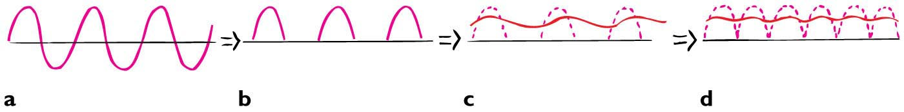
Direct and Alternating Current
Converting from ac to dc
  When input to a diode is ac, output is pulsating dc.
  Slow charging and discharging of a capacitor provides continuous and smoother current.
  A pair of diodes is used, so there are no gaps in current output. The pair of diodes reverses the polarity of alternate half-cycles instead of eliminating them.
  Then capacitors and resistors are used to smooth out the bumps

Slide 30
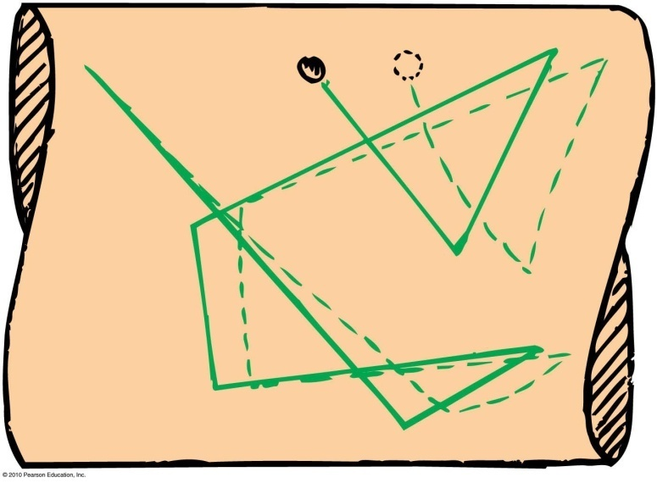
Speed and Source of Electrons in a Circuit
When we flip the light switch on a wall and the circuit,
an electric field is established inside the conductor.
The electrons continue their random motions while simultaneously being nudged by the electric field.
Current is established through the wires at nearly the speed of light.
It is not the electrons that move at this speed.
It is the electric field that can travel through a circuit at nearly the speed of light.

Slide 31
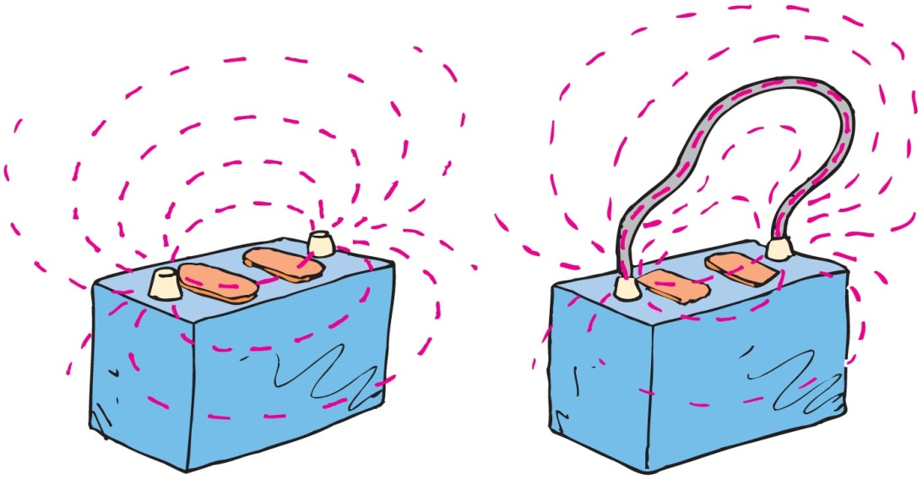
Speed and Source of Electrons in a Circuit
If the voltage source is dc, like the battery, electric field lines are maintained in one direction in the conductor.
Conduction electrons are accelerated by the field in a direction parallel to the field lines.
Before they gain appreciable speed, they “bump into” the anchored metallic ions in their paths and transfer some of their kinetic energy to them.

Slide 32
Speed and Source of Electrons in a Circuit
Misconceptions about electric current:
“Current is propagated through the conducting wires by electrons bumping into one another.”
  NOT true: Electrons that are free to move in a conductor are accelerated by the electric field impressed upon them.
  True, they do bump into one another and other atoms, but this slows them down and offers resistance to their motion.
  Electrons throughout the entire closed path of a circuit all react simultaneously to the electric field.

Slide 33
Speed and Source of Electrons in a Circuit
Misconceptions about electric current:
“Electrical outlets in the walls of the homes are a source of electrons.”
  NOT true: The outlets in homes are ac. Electrons make no net migration through a wire in an ac circuit.
  When you plug a lamp into an outlet, energy flows from the outlet into the lamp, not electrons. Energy is carried by the pulsating electric field and causes vibratory motion.
  Electrical utility companies sell energy. You provide the electrons.

Slide 34
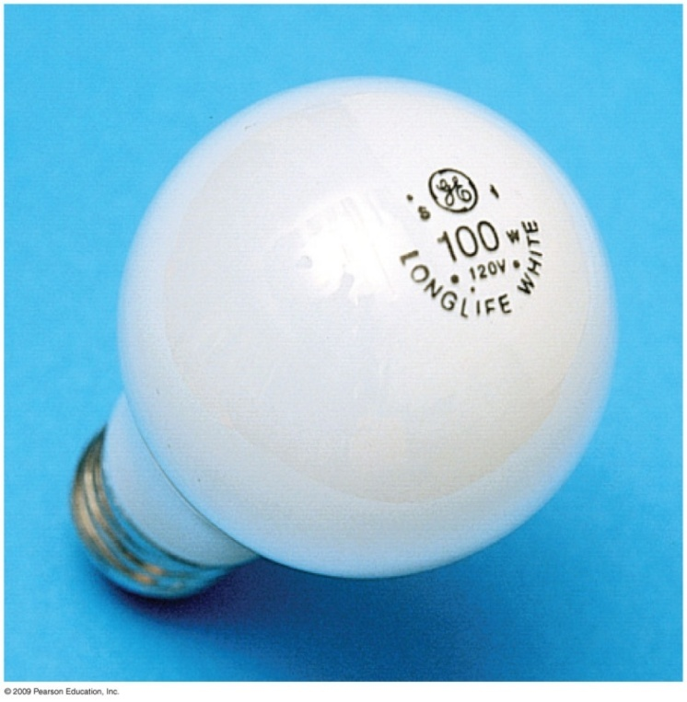
Electric Power
Unless you consider superconductors the charge moving in a circuit expends energy.
Electrical power is the rate at which electric energy is converted into another form: mechanical, heat, light, etc.
In equation form:
Power = current × voltage
In units: watts or kilowatts
Example: 100-watt lamp draws
0.8 ampere at 125 volts.

Slide 35
2. The wattage marked on a light bulb is not an inherent property of the bulb but depends on the voltage to which it is connected, usually 110 or 120 V. How many amperes flow through a 60 W bulb connected in a 120 V circuit?
Watts = amperes x voltage so amperes = watts / voltage
Then amperes = 60 W/ 120 V = 0.5 amps.
4. Using the formula Power = current x voltage, find
the current drawn by a 1200 W hair dryer connected
to 120 V. Then, using the method from the previous
problem, find the resistance of the hairdryer.
Current = power / voltage = 1200 W / 120 V = 10 amps.

Slide 36
Electric Power Continued
Electrical power in our homes is usually discussed in terms of kilowatts (1000 watts)
A kilowatt hour is the amount of energy consumed in one hour at the rate of one kilowatt.

Slide 37
Show that operating a 100-W lamp continuously for 1 week when the power utility rate is 15¢/kWh costs $2.52.
1 week = 7 days x 24 hrs/day = 168 hrs
Power = 100 W x 168 h= 16800W = 16.8 kWh
Cost = 0.15 $/kWh x 16.8 kWh = $2.52
8. An electric iron connected to a 110-V source draws 9 A of current. Show that the amount of heat it generates in a minute is nearly 60,000 J.
Power = current x voltage = 110 V x 9 A = 990 watts = 990 Joules / s x 60 s/min = 59400 J

Slide 38
10. In periods of peak demand, power companies lower their voltage. This saves them power (and saves you money!). To see the effect, consider a 1200-W toaster that draws 10 A when connected to 120 V. Suppose the voltage is lowered by 10% to 108 V. By how much does the current decrease? By how much does the power decrease? (Caution: The 1200-W label is valid only when 120 V is applied. When the voltage is lowered, it is the resistance of the toaster, not its power, that remains constant.)
Power = current x voltage and, current = voltage / resistance
So Power = V² / R
Since R_{toaster} = 120 V / 10 A = 12 Ω then at 108 V
Power = V² / R = (108)² / 12 = 972 W
Power (108/120) =972 W/ 1200W = 0.81 = 81%

Slide 39
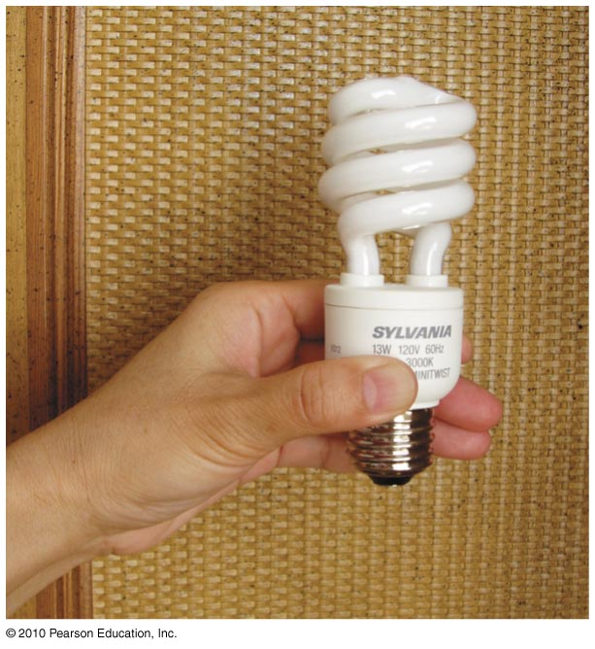
Compact Fluorescent Lamps (CFLs)
Incandescent bulbs dissipate most of their energy in the form of heat, not light. So, they are not energy efficient.
Fluorescent lamps, on the other hand, emit much less heat, which is why you can touch them without burning yourself.
Compact fluorescent lamps (CFLs) are a type of fluorescent lamp that fits into a standard lightbulb socket.
For the same wattage, CFLs emit much more light and much less heat than incandescent bulbs.

Slide 40
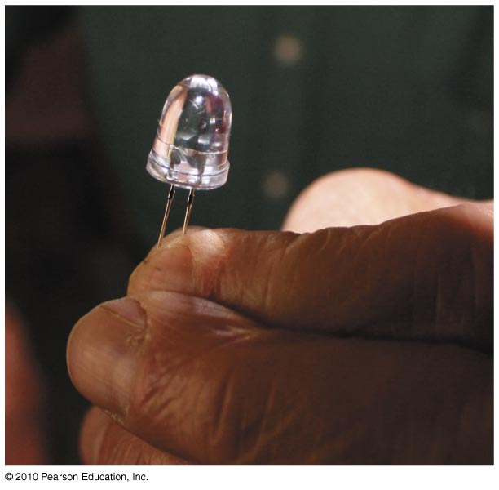
Light-Emitting Diodes (LEDs)
Another light source even more long-lasting is the light-emitting diode (LED).
  The most primitive being the little red lights that tell you whether your stereo is on or off
Between CFLs and LEDs, common-use incandescent bulbs will soon be history.

Slide 41
Electric Circuits
Circuits
Any path along which electrons can flow from the negative terminal to the positive terminal
Complete circuit allows continuous flow of electrons with no openings or gaps

Slide 42
Electric Circuits
Circuits
Connected in two common ways:
  series
    forms a single pathway for electron flow between the terminals of the battery, generator, or wall outlet
  parallel
    forms branches, each of which is a separate path for the flow of electrons

Slide 43
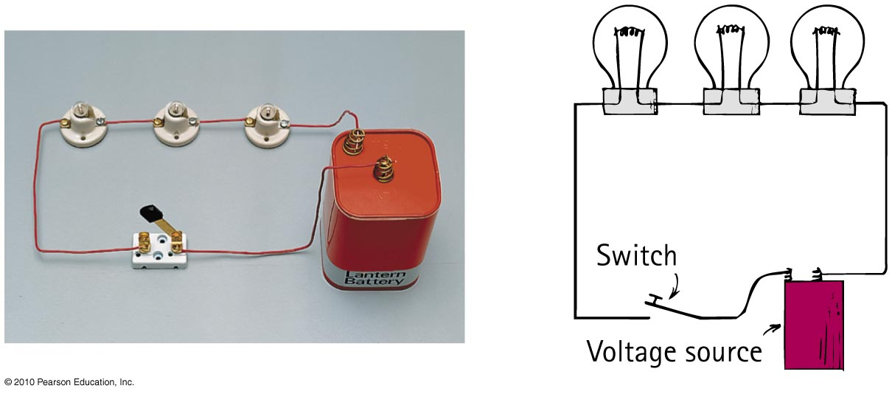
Electric Circuits
Series circuits
Characteristics of series circuit
1. Electric current through a single pathway.
2. Total resistance to current is the sum of individual resistances.
3. Current is equal to the voltage supplied by the source divided by the total resistance of the circuit.

Slide 44
Electric Circuits
Series circuits
Characteristics of series circuit (continued):
4. The total voltage impressed across a series circuit divides among the individual electrical devices in the circuit so that the sum of the “voltage drops” across the resistance of each individual device is equal to the total voltage supplied by the source.
5. The voltage drop across each device are proportional to its resistance.
6. If one device fails, current in the entire circuit ceases.

Slide 45
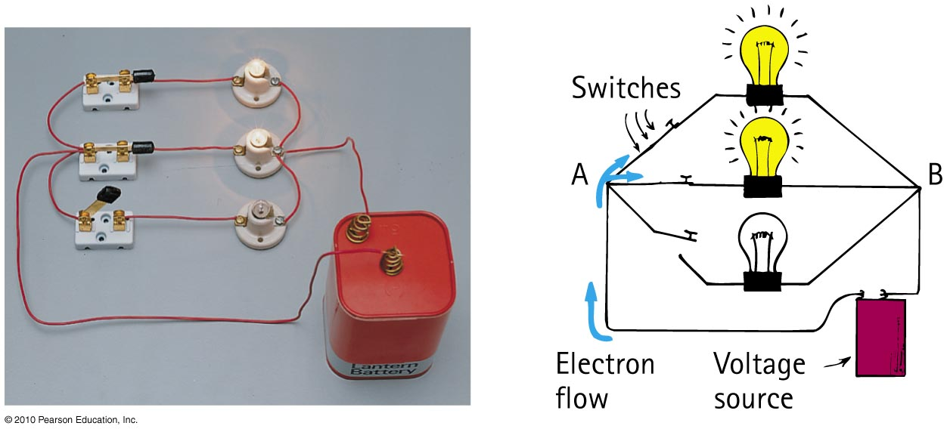
Electric Circuits
Parallel circuits
Characteristics of parallel circuit:
1. Voltage is the same across each device.
2. The total current in the circuit divides among the parallel branches. The amount of current in each branch is inversely proportional to the resistance of the branch.
3. The total current in the circuit equals the sum of the currents in its parallel branches.

Slide 46
Circuit Resistance
In series the
Equivalent Resistance = R1 + R2 + R3
In parallel
1/ Equivalent Resistance = 1/R1 + 1/R2 + 1/R3
Since, I₁ = V / R₁, I₂ = V / R₂, and I₃ = V / R₃
and I = ( I₁+ I₂ + I₃) = (V / R₁ + V / R₂ + V / R₃)
So I = V / Requivalent, then
1/Re = 1/R1 + 1/R2 + 1/R3

Slide 47
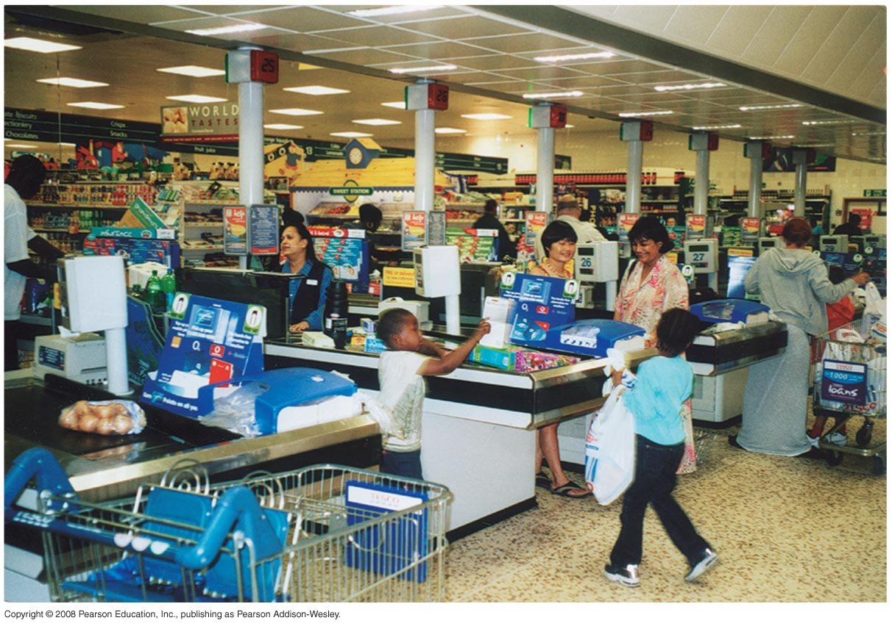
Electric Circuits
Parallel circuits
Characteristics of parallel circuit (continued):
4. As the number of parallel branches is increased, the overall resistance of the circuit is decreased.
5. A break in one path does not interrupt the flow of charge in the other paths.

Slide 48
When two identical lamps in a circuit are connected in parallel, the total resistance is
Electric Circuits
CHECK YOUR NEIGHBOR
A. less than the resistance of either lamp.
the same as the resistance of each lamp.
less than the resistance of each lamp.
None of the above.
Notes:
A. less than the resistance of either lamp.

Slide 49
When two identical lamps in a circuit are connected in parallel, the total resistance is
Electric Circuits
CHECK YOUR ANSWER
A. less than the resistance of either lamp.
the same as the resistance of each lamp.
less than the resistance of each lamp.
None of the above.
Explanation:
Resistors in parallel are like extra lines at a checkout counter. More lines means less resistance, allowing for more flow.
Notes:
A. less than the resistance of either lamp.

Slide 50
Consider a lamp powered by a battery. Charge flows
Electric Circuits
CHECK YOUR NEIGHBOR
A. out of the battery and into the lamp.
from the negative terminal to the positive terminal.
with a slight time delay after closing the switch.
through both the battery and the lamp.
Notes:
D. through both the battery and the lamp.

Slide 51
Consider a lamp powered by a battery. Charge flows
Electric Circuits
CHECK YOUR ANSWER
A. out of the battery and into the lamp.
from the negative terminal to the positive terminal.
with a slight time delay after closing the switch.
through both the battery and the lamp.
Explanation:
Remember, charge is already in all parts of the conducting circuit. The battery simply gets the charges moving. As much charge flows in the battery as outside. Therefore, charge flows through the entire circuit.
Notes:
D. through both the battery and the lamp.

Slide 52
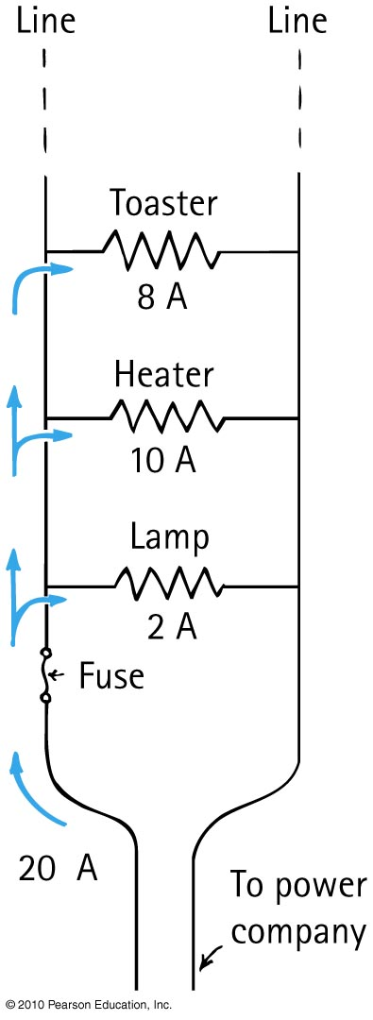
Electric Circuits
Parallel circuits and overloading
Homes are wired in parallel. As more
and more devices are connected to
a circuit, more current moves through
the wires. There is an amount of
current each device can carry before
it overheats. When the current is
excessive, overheating can result in
a fire.

Slide 53
Electric Circuits
Parallel circuits and overloading (continued)
Also, the addition of excess devices in a parallel circuit increases the amount of current moving through the wires, producing an overload and overheating of the system, which can result in a fire.

Slide 54
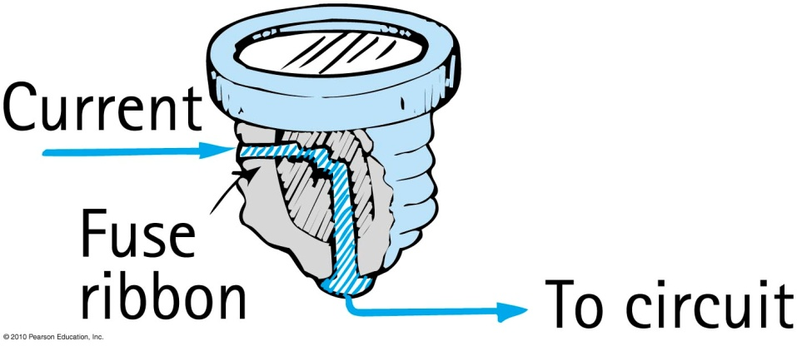
Electric Circuits
Safety fuses
Are wires that melt when the given current is exceeded
Are connected in series along the supply line to prevent overloading in circuits
Are replaced by circuit breakers in modern buildings
Circuit breaker
Automatic switch that turns
off when the current is excessive

